Slide 1

MODELLING CIRCADIAN RHYTHMS IN NENGO
Natasha Thomare
Parmandeep Chaddha
Saad Arif Qadeer

Slide 2
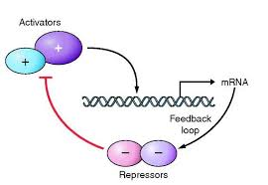
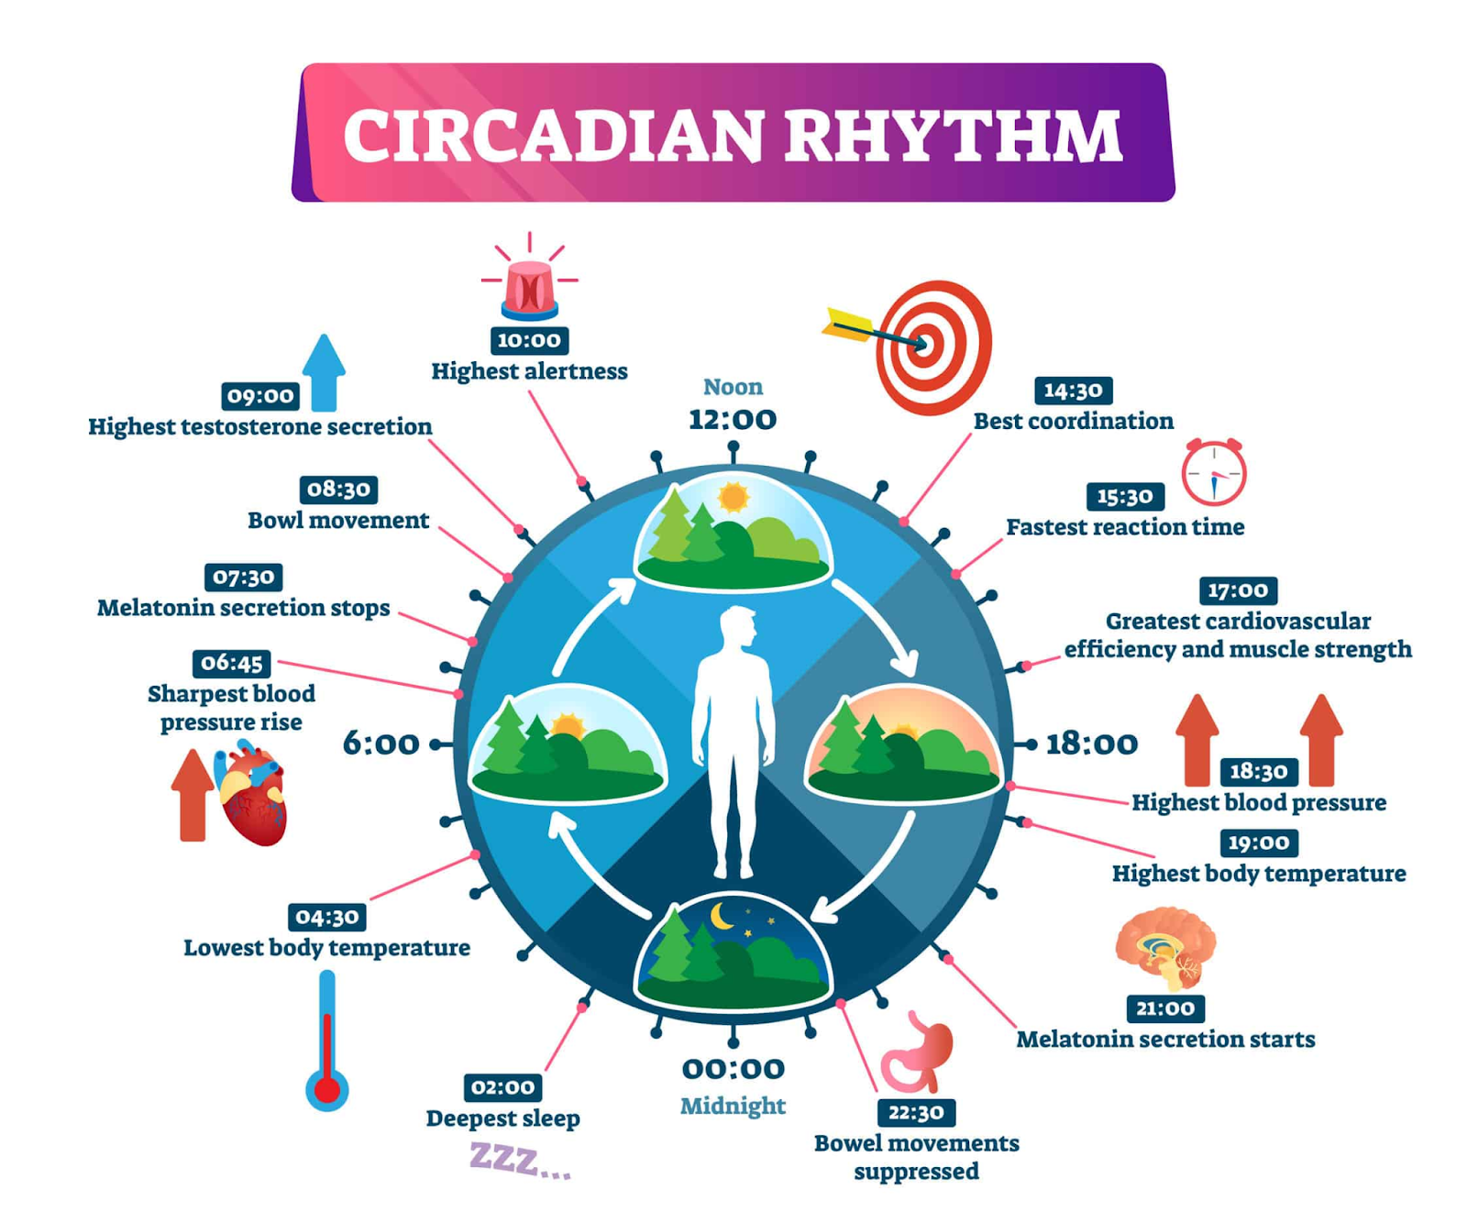
Background And Context
What are Circadian rhythms?
The goal of computational models in circadian rhythm research
Biological implications of circadian rhythms
Relationship between PER gene and per-mRNA
(Andrew, 2016)
(Kelly, 2020)

Slide 3
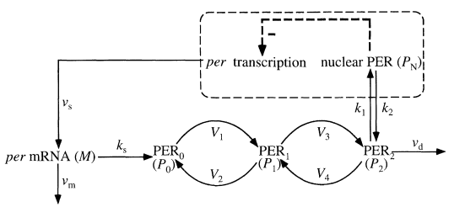

Slide 4
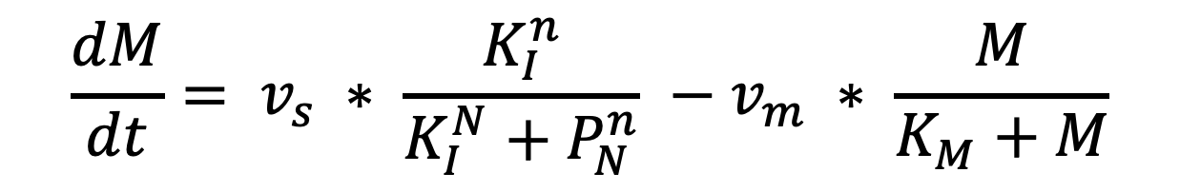
The Circadian Rhythm
$$\frac{dM}{dt}= v_{s} ∗ \frac{K_{I}^{n}}{K_{I}^{N}+P_{N}^{n}} −v_{m} ∗ \frac{M}{K_{M}+M}$$
In general rate of accumulation= rate of production - rate of degradation
This is a first order differential equation showing the rate of accumulation of cytoplasmic pre-mRNA over time.
M -> accumulation of cytoplasmic per-mRNA
v_{s} -> maximum rate for accumulation of M
K_{I} -> threshold constant of inhibition
P_{N} -> concentration of PER in nucleus
n -> Hill coefficient, the minimum number of cooperating molecules required to achieve inhibition
v_{m} -> maximum rate for degradation of M,
Km -> Michaelis constant for the degradation reaction

Slide 5
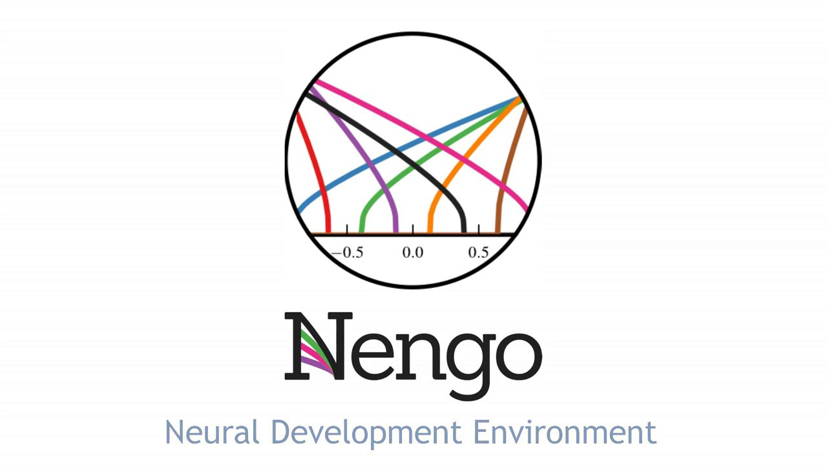
What is Nengo(Neural Engineering Objects)

Slide 6

What is Nengo used for?
Deep learning
Neuromorphic hardware
Online learning
Neural Engineering Framework
Cognitive modelling with SPA(Single Page Application)
(Huang, 2019)

Slide 7
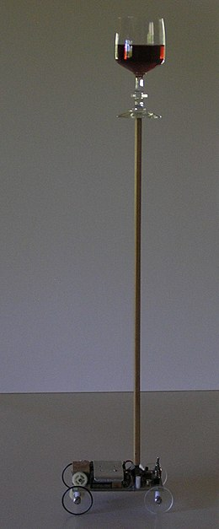
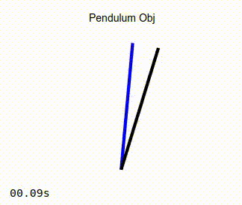
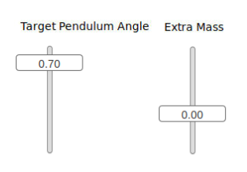
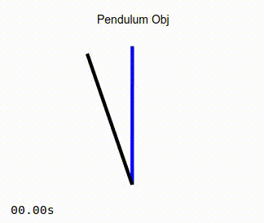
Nengo Example- Inverted Pendulum
Non-Adaptive Controller
2 inputs the user can control
Target pendulum angle
Mass of the pendulum
Blue line represents the target, desired position of pendulum
Black line is the actual position of pendulum
Adaptive Controller
(Clark, 2022)

Slide 8
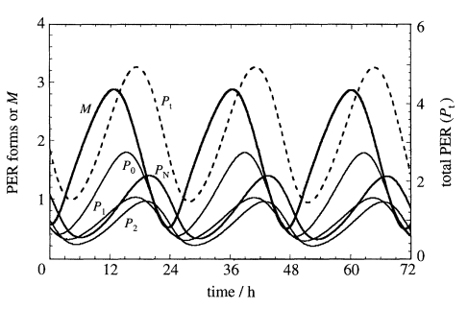
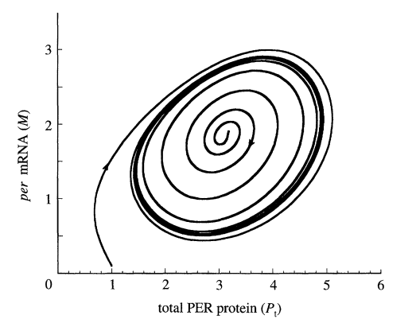
Simulation Results, Goldbeter Et Al.
(Leloup & Goldbeter, 1997)

Slide 9
Live Demo

Slide 10
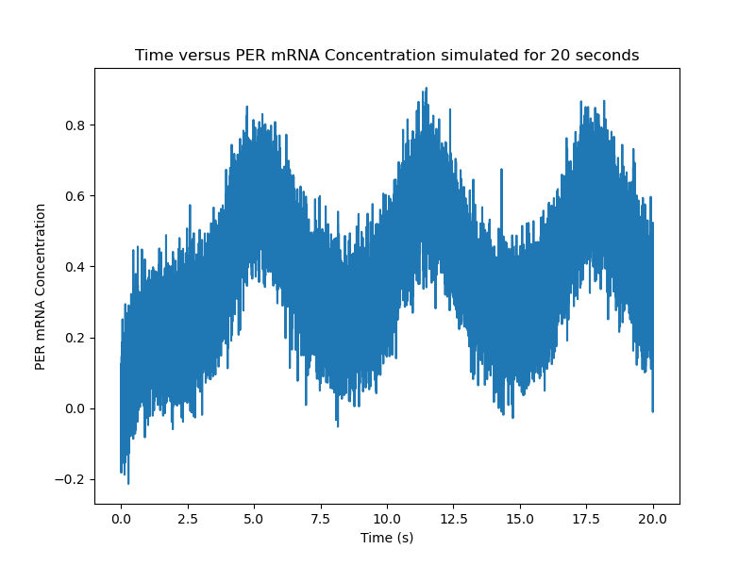
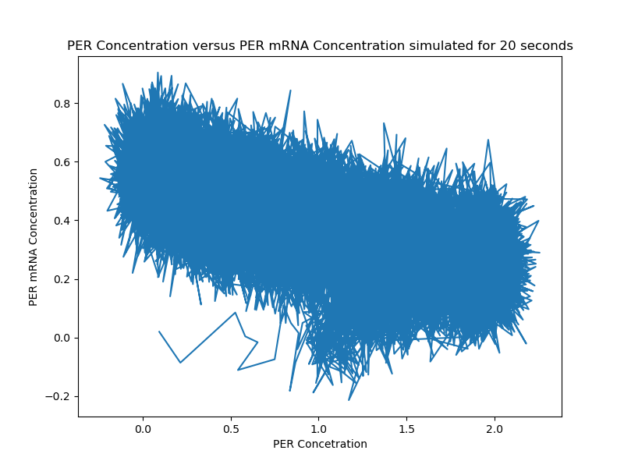
Our Results / Demo

Slide 11
Thanks for Listening!

Slide 12
References
Andrew, A. (2016, January 12). Period. ADBScience. Retrieved March 31, 2022, from https://adbscience.com/tag/period/
Bechtel, W., & Abrahamsen, A. (2010). Dynamic mechanistic explanation: Computational modeling of circadian rhythms as an exemplar for cognitive science. Studies in History and Philosophy of Science Part A, 41(3), 321–333. https://doi.org/10.1016/j.shpsa.2010.07.003
Bekolay, T., Bergstra, J., Hunsberger, E., DeWolf, T., Stewart, T. C., Rasmussen, D., Choo, X., Voelker, A. R., & Eliasmith, C. (2014). Nengo: A python tool for building large-scale functional brain models. Frontiers in Neuroinformatics, 7. https://doi.org/10.3389/fninf.2013.00048
Examples¶. Nengo. (n.d.). Retrieved March 31, 2022, from https://www.nengo.ai/nengo-fpga/examples.html#adaptive-pendulum-control
Huang, L. (2019, December 11). Artificial neural network with Chip. Flickr. Retrieved March 31, 2022, from https://www.flickr.com/photos/186021024@N08/49203125457
Kelly, C. (2020, July 6). What is circadian rhythm? - disorders, symptoms, health effects. Prescription Hope. Retrieved March 31, 2022, from https://prescriptionhope.com/blog-what-is-circadian-rhythm-disorders-symptoms-health-effects/
Leloup, J.-C., & Goldbeter, A. (1997). Temperature compensation of circadian rhythms: Control of the period in a model for circadian oscillations of the PER protein in drosophila. Chronobiology International, 14(5), 511–520. https://doi.org/10.3109/07420529709001472
Wikimedia Foundation. (2022, March 13). Inverted pendulum. Wikipedia. Retrieved March 31, 2022, from https://en.wikipedia.org/wiki/Inverted_pendulum#/media/File:Balancer_with_wine_3.JPG

